Slide 1
Latent Curve Modeling
Beaujean Chapter 5

Slide 2
Latent Curve Modeling
Measuring change over repeated time measurements
Gives you more information than a repeated measures test – even if you use a linear post hoc analysis.

Slide 3
Latent Curve Modeling
Advantages:
Estimate means and covariances separately
Estimating observed values and unobserved values separately
You can’t really get the unobserved in RM

Slide 4
Assumptions
Continuous measurement of the DVs
This assumption is true for all of SEM though.
Time spacing is the same across people
NOT across measurements, but people need to be spaced the same

Slide 5
Assumptions
At least three time points per person
(otherwise it’s a dependent t-test)
Larger samples (N>200)

Slide 6
Before you start…
You have to know the expected type of change before you start
Generally it’s linear (hence linear growth models)
But it can be curvilinear or power functions, etc.

Slide 7
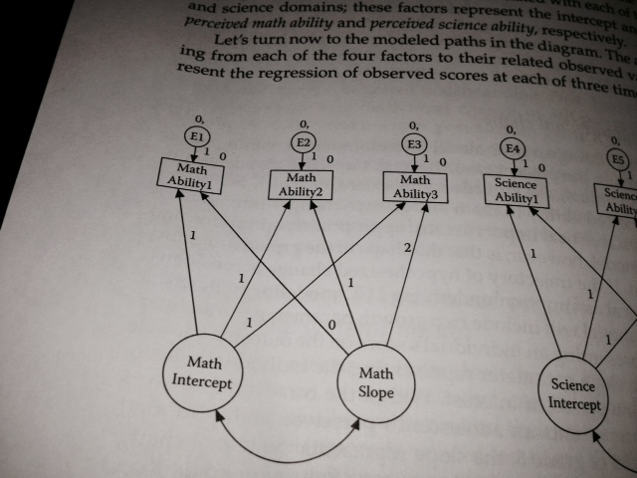

Slide 8
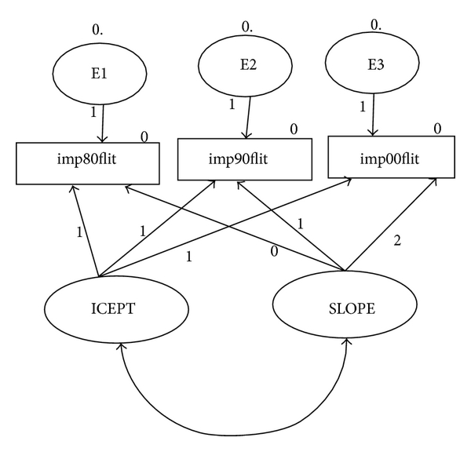

Slide 9
Linear Models
So, we will set the regression loading values to specific numbers to be able to estimate intercept and slope.

Slide 10
Linear Models
Intercept
You set these values to 1 indicating that you do NOT want to estimate them
Basically that gives you a starting value for the first time point … the average point where people start, which is the y-intercept.

Slide 11
Linear Models
Slope – represents the change over time
You can set these values to anything you want
Usually the first time is indicated by a 0
There’s no slope for time 1, just an intercept
Then the paths are set based on the time differences between them

Slide 12
Linear Models
Setting the parameters this way:
Helps with identification
Is theoretical to match the concept of slope and intercept estimation
Allows you to not have to set the variances, so you can look at them.

Slide 13
Questions
What is the average change for each person?
Where do they start?
How does it change over time?
What is the form of the change?

Slide 14
Questions
Is the average slope and intercept a good fit for all participants?
Or should we include a variance term to account for the differences between people?
Models are called random effects if you add the random variances.

Slide 15
Questions
If we have a random effects model – is there another variable that explains those random effects?

Slide 16
Understanding the Output
Intercept mean = the average starting point for time 1
Slope mean = the average increment across time points

Slide 17
Understanding the Output
Intercept variance = the spread around the average start point
Large scores indicate a lot of spread – meaning people start in a lot of different places
Small scores indicate a small spread – everyone starts about the same place

Slide 18
Understanding the Output
Slope variance – the range of increments across time points
Small variances mean that everyone is going up/down about the same amount
Large variances mean that people scores are going up/down differently (almost like an interaction)

Slide 19
Understanding the Output
Factor covariance – examines the relationship between intercept and slope
If you have a positive covariance – people who start higher go up faster
(high intercepts are tied to high slopes)
Remember this interpretation is based on if the slope is positive or negative
Positive covariance and negative slopes – people who start high go down faster
(high intercepts are tied to high negative slopes)

Slide 20
Understanding the Output
Factor covariance – examines the relationship between intercept and slope
If you have a negative covariance – people who start higher go up slower
(high intercepts are tied to low slopes)
Remember this interpretation is based on if the slope is positive or negative
Negative covariance and negative slopes – people who start high go down slower
(high intercepts are tied to low negative slopes)

Slide 21
New function
growth()
This function helps with the set up for a LCM, fixes the parameters correctly for you.

Slide 22
Different models to test
This procedure is very similar to multigroup model testing, only in reverse.
We are going to start with the most constrained model and slowly let parameters free to see which is the best.
We would prefer the unconstrained model be the best, which implied that the slope and intercept are useful (but the variances to be low).

Slide 23
First Model
Intercept only model
No slope. You want this model to be bad, otherwise you are saying that one average score is the best for all the time points.
Intercept variance is constrained to 0, so you only get a mean.
Residuals are forced to be the same for each time point. (so the variance is the same across all time points).

Slide 24
Second Model
Intercept only model
We allow the intercept variance to be > 0
People can start at different places
Random intercept model
Residual variances are still the same
Still no slope

Slide 25
Third Model
Add in the slope
However, set this to a random slope
s~0*1 (makes the average slope 0)
s~~0*i (uncorrelated slope/intercept)
Leave the intercept and its variance in the model
Keep the residuals constrained to be the same

Slide 26
Fourth Model
Allow the slope and intercept to vary
Constrain the residual variances

Slide 27
Fifth Model
Totally unconstrained model
Now the residuals are free to vary
You want the residuals to be small and roughly equal, so this model shouldn’t be any different than the previous model

